Slide 1
Temperature of the Essayist
Megan and Cason Wight

Slide 2
Agenda
Introduce ourselves
Backgrounds
Introduce AI
What is a model?
How do neural nets predict?
What is a transformer?
Large Language Models
Assessing the unpredictability of authors
Word trees of probabilities
Perplexity
Mimicking the essayist
Temperature in LLMs
Autocomplete a single word
Autocomplete a whole paragraph
Match the perplexity of the author, and finish the whole essay
Conclusions

Slide 3

Purpose of a Neural Net

Slide 4
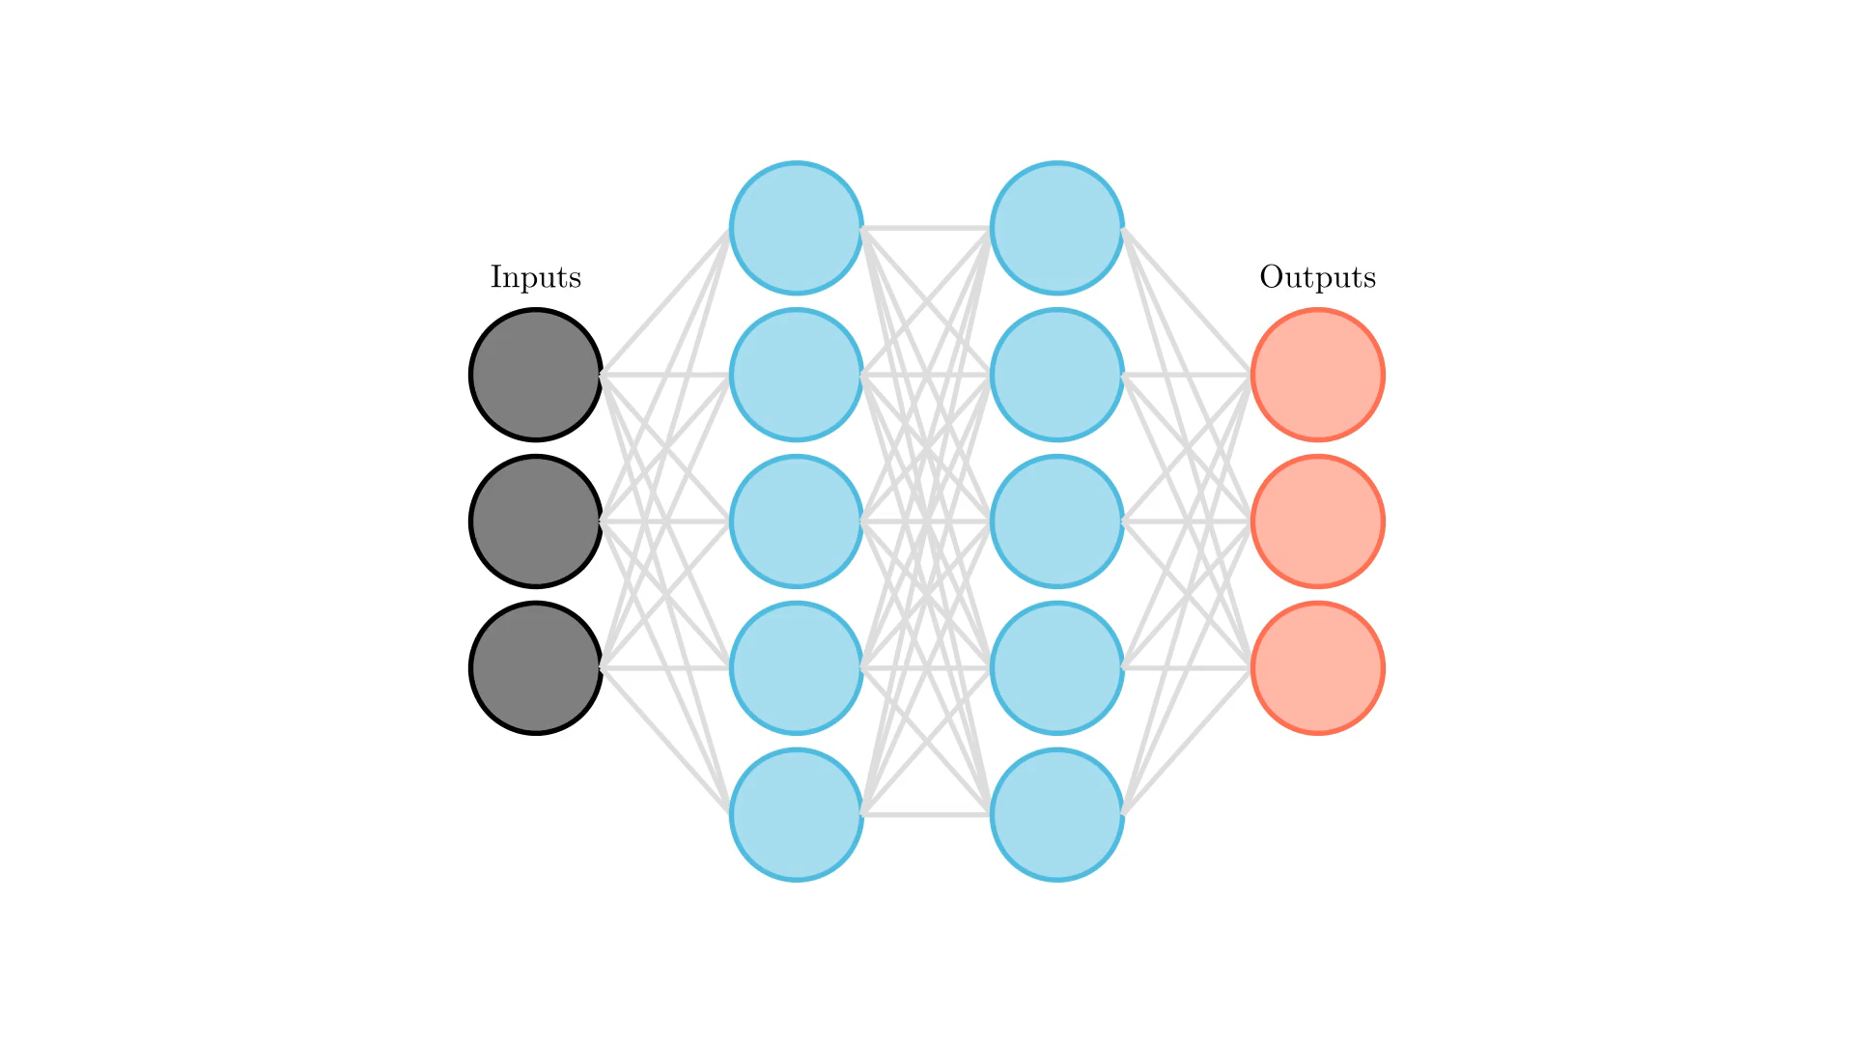
Structure of a Neural Net

Slide 5

Transformers

Slide 6
Timeline of Large Language Models
OpenAI creates Generative Pre-trained Transformer, GPT-1
(117M parameters)
Google and U of Toronto introduce the Transformer
OpenAI creates GPT-3
(175B parameters)
OpenAI creates ChatGPT
(Using GPT-3)
Jun 2017
Jun 2018
Jun 2020
Nov 2022
Oct 2018
July 2022
Google creates Bidirectional Encoder Representation for Transformer, BERT
(110M parameters)
Volunteer researches create BigScience Large Open-science Open-access Multilingual Language Model, BLOOM
(176B parameters)

Slide 7
